Slide 1
Agenda Item 13 How to Promote INTOSAI Community Portal as Knowledge Portal of INTOSAI
11th Meeting of KSC Steering Committee
Pampanga, Philippines
(12-14 June 2019)
SAI-India

Slide 2
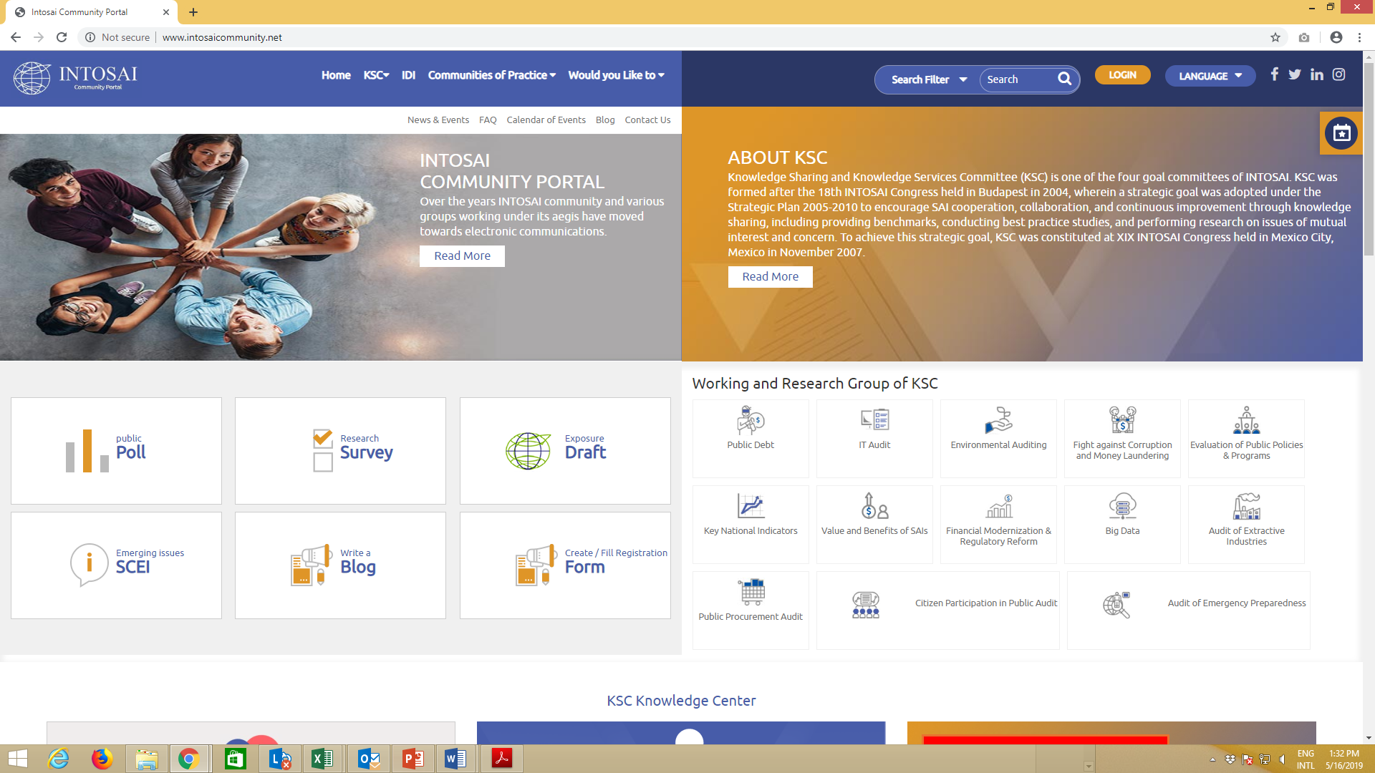
www.intosaicommunity.net Website migration
Consolidation of Working Group websites
WGITA –
WGKNI, WGEI, WGPD, WGPPA-
WGEA, WGVBS, WGBD, WGFACML, WGFMRR, WGEPPA -
Seeks volunteers from KSC SC member SAIs
SAI India offers to engage its nominees to Working Groups to act as focal persons to complete migration of all websites

Slide 3
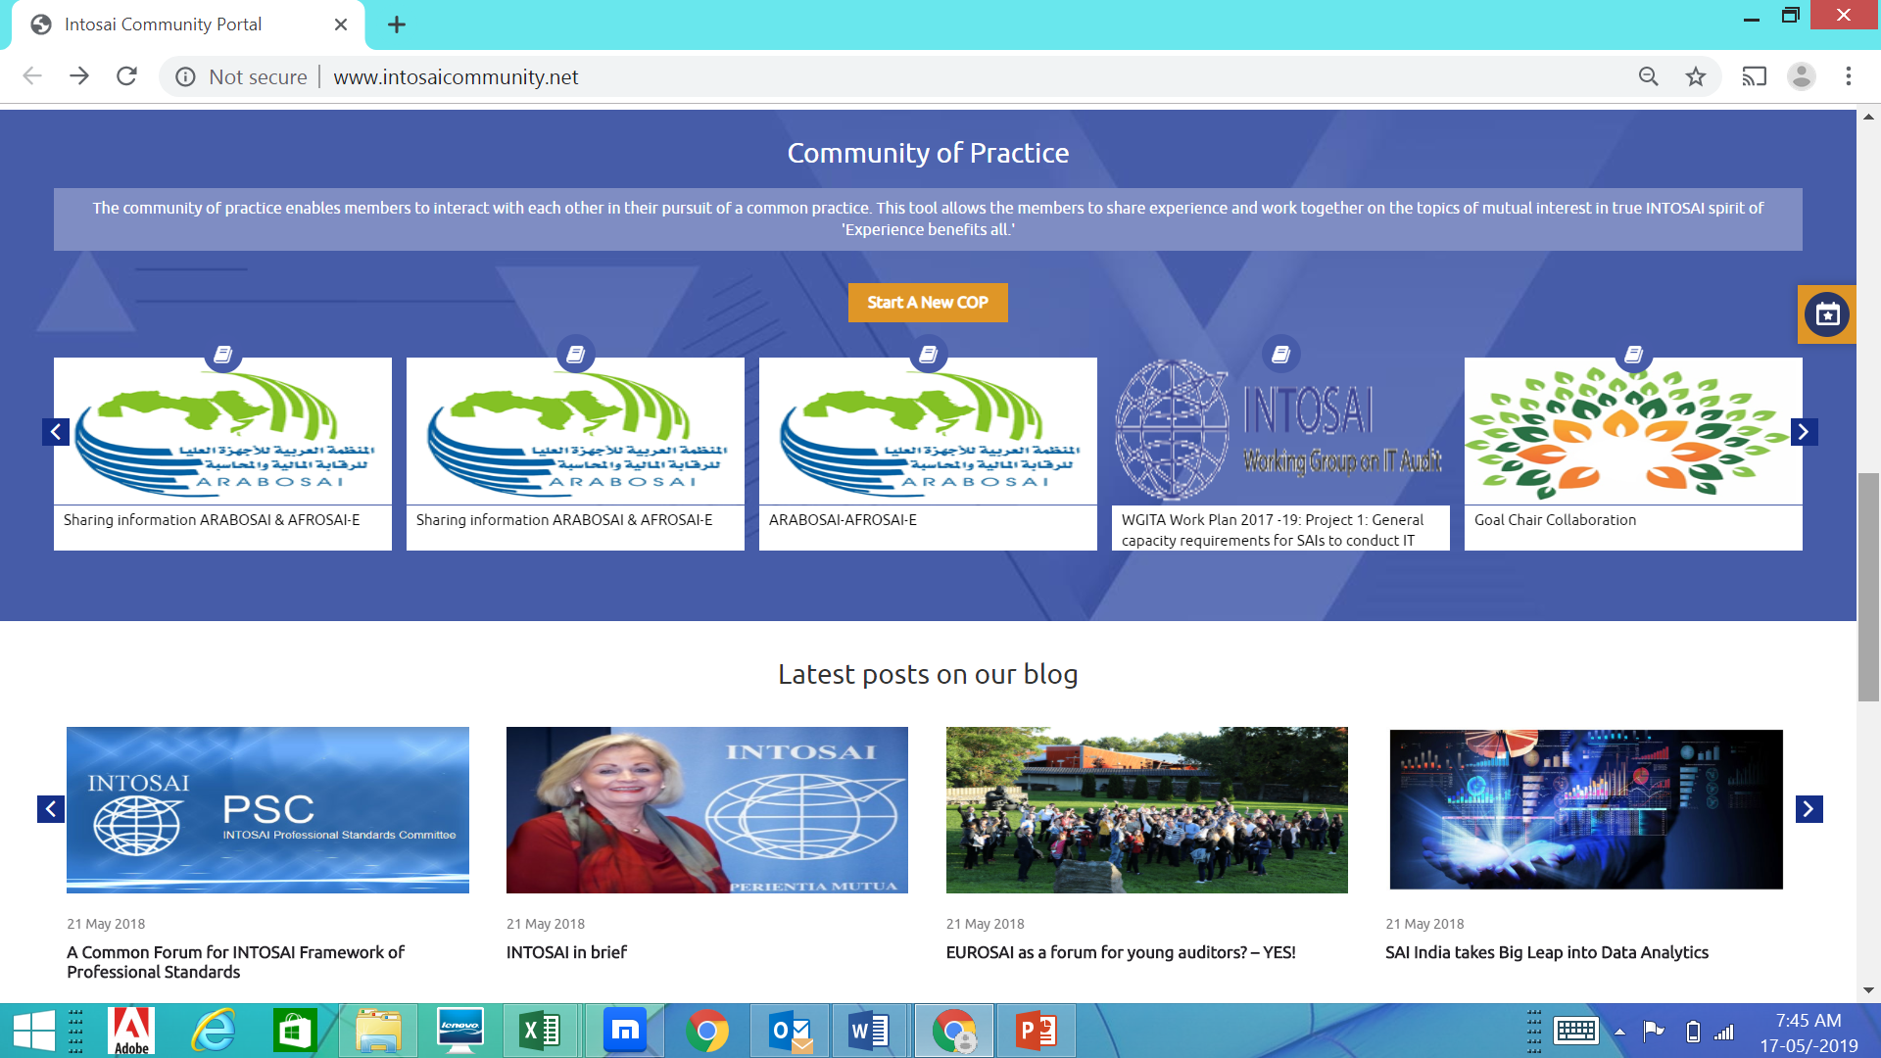
Content Enrichment – Library resources
INTOSAI publications
KSC SC to upload
Guidance documents
Working groups to upload
SAI publications
WGs to take up activity to create and maintain audit report databases
Training material and good practices
WGs and IDI
Portal Admin to share CMS credentials with designated persons

Slide 4
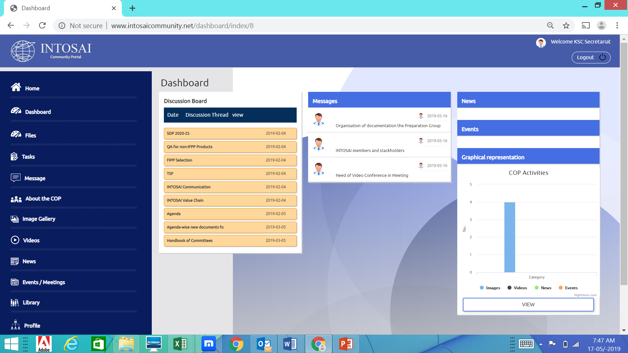
Enhance collaboration – Using CoPs
Few CoPs - Low awareness even among project teams
All WG member SAIs may get project team members to register
SAI India nominees to WGs may be involved by the Working Groups to create and manage CoPs on projects undertaken by the Group
New collaboration features like creation of tasks and messaging within the CoP can be refined only by user feedback

Slide 5
Increase user accounts
Real time features are accessible to registered users only
WG Chairs may request member SAIs to get staff to register on the community portal
Registered users would be able to
Create a survey
Host Video Conference and Webinars
Participate in Q & A
Add events to the calendar for visibility of WG/ SAI activities across the INTOSAI Community
Post blogs and comments

Slide 6
Spreading the message
IDI and regional organisations can help in popularizing usage
KSC representatives in Regional meetings may demonstrate the value of the portal
Experience sharing videos by active CoP members
WG project teams to take the lead in usage of features and populate the knowledge resources with audit reports and SAI case studies

Slide 7
www.intosaicommunity.net Road ahead
Improve search functionality
Engage consultant for content management and user interaction
Develop mobile app for user-specific experience

Slide 8
THANK YOU

